Slide 1
Salary compensation analysis through excel data modelling
STUDENT NAME: Jestina Mary McKenzie
REGISTER NO: 312216954/
DEPARTMENT: B. Com (general)
COLLEGE Shri Krishnaswamy college for women

Slide 2
PROJECT TITLE
Salary and compensation analysis through excel data modelling

Slide 3


AGENDA
Problem Statement
Project Overview
End Users
Our Solution and Proposition
Dataset Description
Modelling Approach
Results and Discussion
Conclusion
3/21/2024 Annual Review

Slide 4

PROBLEM STATEMENT
The organization needs to address potential inefficiencies and disparities in its salary compensation structure. There is a need for a comprehensive analysis of salary data to ensure that compensation is fair, competitive, and aligned with industry standards. Currently, there is insufficient visibility into how salaries are distributed across different roles, departments, and locations, and how they compare with industry benchmarks.

Slide 5

PROJECT OVERVIEW
To analyse and optimize the organization’s salary compensation structure by identifying patterns, disparities, and alignment with industry benchmarks through comprehensive data modeling in Excel. The ultimate goal is to ensure fair, competitive, and strategically aligned compensation practices.

Slide 6

WHO ARE THE END USERS?
Human Resources (HR) Managers: They use the analysis to ensure fair and competitive compensation practices, make informed decisions on salary adjustments, and develop compensation policies.
Compensation Analysts: These professionals rely on the data to evaluate salary structures, identify discrepancies, and benchmark against industry standards.
Finance Teams: They use the insights for budgeting and forecasting salary-related expenses.
Executives and Senior Management: They use the findings to make strategic decisions regarding overall compensation strategies and to ensure alignment with organizational goals.
Recruitment Teams: They use the data to develop competitive job offers and attract top talent by ensuring their compensation packages are aligned with market standards.
Department Heads and Line Managers: They may use the analysis to understand compensation trends and support equitable pay decisions within their teams.

Slide 7

OUR SOLUTION AND ITS VALUE PROPOSITION
Informed Decisions: Data-driven insights for better salary adjustments and compensation strategies.
Fairness: Identifies and addresses pay disparities, promoting equity.
Competitiveness: Ensures compensation packages are in line with industry standards, enhancing talent attraction and retention.
Transparency: Clear visualizations and reports for improved communication and understanding.
Strategic Alignment: Aligns compensation with organizational goals and industry benchmarks.
Efficiency: Streamlines the analysis process, reducing manual effort and improving compensation management

Slide 8
Dataset Description
Employee ID: Unique identifier for each employee.
Name: Employee’s full name (optional for analysis, depending on privacy policies).
Job Title: The official job title or position held by the employee.
Department: The department or team to which the employee belongs.
Location: Geographic location or office where the employee works.
**2. Compensation Details:
Base Salary: Annual base salary amount.
Bonus: Any performance-based or discretionary bonuses.
Total Compensation: Sum of base salary and bonuses (if applicable).
**3. Demographic Information:
Gender: Employee’s gender (optional, depending on privacy policies and relevance).
Age: Employee’s age or age group.
Experience Level: Years of relevant work experience.

Slide 9

THE "WOW" IN OUR SOLUTION
The “wow” factor in our solution is its ability to deliver a comprehensive, interactive Excel-based model that integrates diverse data points for an in-depth analysis of salary compensation. This model provides dynamic visualizations and precise benchmarking against industry standards, leading to actionable recommendations that ensure fair, competitive, and strategically aligned compensation practices while enhancing efficiency and accuracy.
3/21/2024 Annual Review
9

Slide 10
MODELLING
Data Consolidation:
Integrate data from HR systems, payroll, and performance reviews into a unified Excel model.
Data Structuring:
Organize data into sheets for Employee Info, Compensation, Demographics, Performance, and Employment Details.
Validate data for accuracy and consistency.
Data Analysis:
Perform statistical analysis to determine salary distributions and identify disparities.
Visualization: Create dynamic charts and dashboards to illustrate key insights and trends.
10

Slide 11
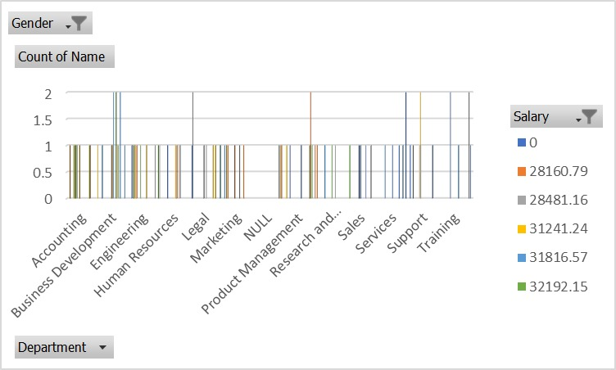
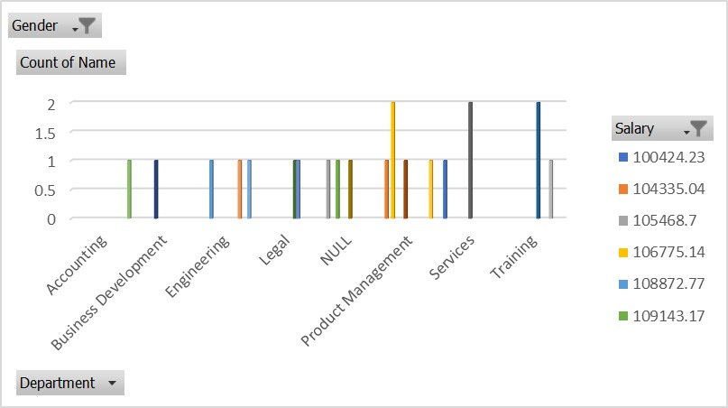
RESULTS
11

Slide 12
conclusion
The Excel model transforms salary compensation analysis by seamlessly integrating diverse data sources to reveal impactful trends and disparities. Its dynamic visualizations turn complex insights into clear, actionable recommendations, empowering the organization to enhance fairness, competitiveness, and strategic alignment in compensation practices.

